Slide 1

Report on definitive data timelines Jan Reda
Intermagnet Meeting Online, 13-15 Jul 2020

Slide 2
One-minute definitive data collection Summary of 2017, 2018, 2019
Definitive 2017
(situation of 2020-07-07, 2 years after deadline))
Received binary (step1): 120 IMOs
After cross-checking (step2): 113 *1
Fully accepted (on Intermagnet web): 113
Definitive 2018
(situation of 2020-07-10, 1 year after deadline)
Received binary (step1): 112 IMOs
After cross-checking (step2): 97 *2
Fully accepted (on Intermagnet web): 96 *3
Definitive 2019
(situation of 2020-07-07, 1.5 weeks after deadline)
Received binary (step1): 76 IMOs (maximally expected about 120)
After cross-checking (step2): 34
Fully accepted (now or soon on web): 31
*1 missing DLT, JAI, ORC, PEG, SJG,SON, SPG
(Dalat, Jaipur, Orcadas, Penteli, San Juan, Sonmiani, Saint Petersburg)
*2 missing BLC, BMT, CBB, CYG, DED, DLT, HER, NUR, ORC, PEG, SJG, SON, SPG, SUA, VAL
(Baker Lake, Beijing Ming Tom, Cambridge Bay, Cheongyang, Deadhorse, Dalat, Hermanus, Nurmijarvi, Orcadas, Penteli,
San Juan, Sonmiani, Saint Petersburg, Surlari, Valentia)
*3 missing NAQ (Narsarsuaq)

Slide 3
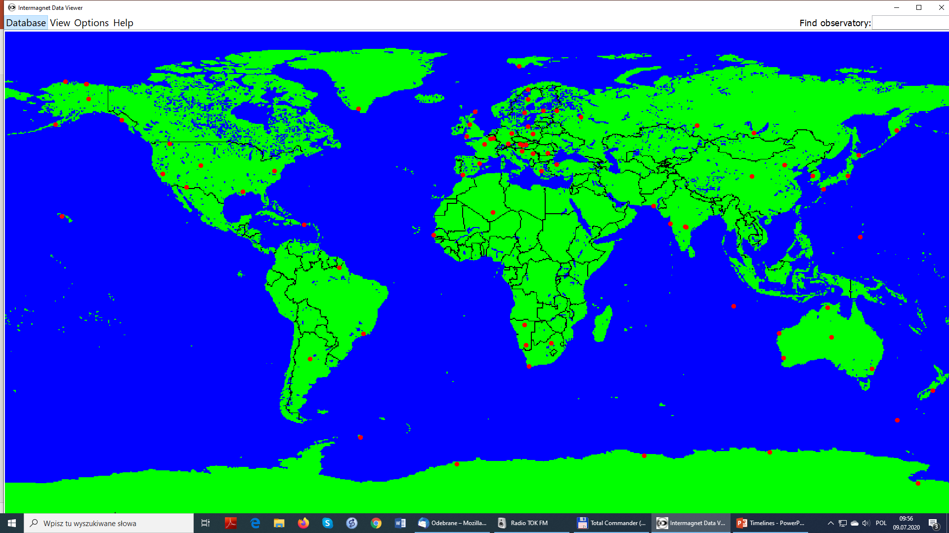

PROVIDED ON TIME 2019
2019 definitive provided ontime
(deadline was Jul 1-st 2020)
about 80 IMOs
already about 35 fully checked
and accepted
NOT YET PROVIDED 2019
2019 definitive not provided
until now
about 40 IMOs have not provided
Remark:
For 2019 situation is a bit better than
in previous years.
Maybe IMOs have more time
because of pandemia.

Slide 4
 |  |  |  |  | Situation at the beginning of July 2020
 |  | 2016_step | 2016_step2 | 2016_step3 | 2016_remarks | 2017_step1 | 2017_step2 | 2017_step3 | 2017_remarks | 2018_step1 | 2018_step2 | 2018_step3 | 2018_remarks | 2019_step1 | 2019_step2 | 2019_step3 | 2019_remarks
AAA |  |  |  |  |  |  |  |  |  |  |  |  |  |  |  |  |  | AAA
ABG |  | + | + | + |  | + | + | + |  | + | + | + |  | + | + |  |  | ABG
ABK |  | + | + | + |  | + | + | + |  | + | + | + |  | + |  |  |  | ABK
AIA |  | + | + | + |  | + | + | + |  |  |  |  |  |  |  |  |  | AIA
API |  | + | + | + |  | + | + | + |  | + | + | + |  |  |  |  |  | API
ARS |  |  |  |  |  |  |  |  |  | + | + | + |  |  |  |  |  | ARS
ASC |  | + | + | + |  | + | + | + |  | + | + | + |  |  |  |  |  | ASC
ASP |  | + | + | + |  | + | + | + |  | + | + | + |  | + | + | + |  | ASP
BDV |  | + | + | + |  | + | + | + |  | + | + | + |  |  |  |  |  | BDV
BEL |  | + | + | + |  | + | + | + |  | + | + | + |  | + |  |  |  | BEL
BFO |  | + | + | + |  | + | + | + |  | + | + | + |  |  |  |  |  | BFO
BLC |  | + | + | + |  | + | + | + |  | + |  |  |  |  |  |  |  | BLC
BMT |  | + | + | + |  | + | + | + |  | + |  |  |  | + |  |  |  | BMT
BOU |  | + | + | + |  | + | + | + |  | + | + | + |  | + |  |  |  | BOU
BOX |  | + | + | + |  | + | + | + |  | + | + | + |  | + | + | + |  | BOX
BRD |  | + | + | + |  | + | + | + |  | + | + | + |  |  |  |  |  | BRD
BRW |  | + | + | + |  | + | + | + |  | + | + | + |  | + |  |  |  | BRW
BSL |  | + | + | + |  | + | + | + |  | + | + | + |  | + |  |  |  | BSL
CBB |  | + | + | + |  | + | + | + |  | + |  |  |  |  |  |  |  | CBB
CKI |  | + | + | + |  | + | + | + |  | + | + | + |  | + |  |  |  | CKI
CLF |  | + | + | + |  | + | + | + |  | + | + | + |  | + | + | + |  | CLF
CMO |  | + | + | + |  | + | + | + |  | + | + | + |  | + |  | + |  | CMO
CNB |  | + | + | + |  | + | + | + |  | + | + | + |  | + |  |  |  | CNB
CPL |  | + | + | + |  | + | + | + |  | + | + | + |  | + |  |  |  | CPL
CSY |  | + | + | + |  | + | + | + |  | + | + | + |  | + |  |  |  | CSY
CTA |  | + | + | + |  | + | + | + |  | + | + | + |  |  |  |  |  | CTA
CYG |  | + | + | + |  | + | + | + |  | + |  |  |  | + |  |  |  | CYG
CZT |  |  |  |  |  |  |  |  |  |  |  |  |  |  |  |  |  | CZT
DED |  | + | + | + |  | + | + | + |  | + |  |  |  |  |  |  |  | DED
DLT |  | + | + | + |  | + |  |  |  | + |  |  |  |  |  |  |  | DLT
DOU |  | + | + | + |  | + | + | + |  | + | + | + |  | + | + | + |  | DOU
DRV |  |  |  |  |  |  |  |  |  |  |  |  |  |  |  |  |  | DRV
DUR |  | + | + | + |  | + | + | + |  |  |  |  |  |  |  |  |  | DUR
EBR |  | + | + | + |  | + | + | + |  | + | + | + |  | + |  |  |  | EBR
ESK |  | + | + | + |  | + | + | + |  | + | + | + |  | + | + | + |  | ESK
EYR |  | + | + | + |  | + | + | + |  | + | + | + |  | + |  |  |  | EYR
FCC |  | + | + | + |  | + | + | + |  | + | + | + |  |  |  |  |  | FCC
FRD |  | + | + | + |  | + | + | + |  | + | + | + |  | + |  |  |  | FRD
FRN |  | + | + | + |  | + | + | + |  | + | + | + |  | + |  |  |  | FRN
FUR |  | + | + | + |  | + | + | + |  | + | + | + |  | + | + | + |  | FUR
GAN |  | + | + | + |  | + | + | + |  |  |  |  |  |  |  |  |  | GAN
GCK |  | + | + | + |  | + | + | + |  | + | + | + |  | + |  |  |  | GCK
GDH |  | + | + | + |  | + | + | + |  | + | + | + |  |  |  |  |  | GDH
GNG |  | + | + | + |  | + | + | + |  | + | + | + |  | + |  |  |  | GNG

Slide 5
 |  |  |  |  | Situation at the beginning of July 2020
 |  | 2016_step | 2016_step2 | 2016_step3 | 2016_remarks | 2017_step1 | 2017_step2 | 2017_step3 | 2017_remarks | 2018_step1 | 2018_step2 | 2018_step3 | 2018_remarks | 2019_step1 | 2019_step2 | 2019_step3 | 2019_remarks
GUA |  | + | + | + |  | + | + | + |  | + | + | + |  | + | + | + |  | GUA
GUI |  | + | + | + |  | + | + | + |  |  |  |  |  |  |  |  |  | GUI
HAD |  | + | + | + |  | + | + | + |  | + | + | + |  | + | + | + |  | HAD
HBK |  | + | + | + |  | + | + | + |  | + | + | + |  | + | + | + |  | HBK
HER |  | + | + | + |  | + | + | + |  | + |  |  |  | + | + |  |  | HER
HLP |  | + | + | + |  | + | + | + |  | + | + | + |  | + |  |  |  | HLP
HON |  | + | + | + |  | + | + | + |  | + | + | + |  | + |  |  |  | HON
HRB |  | + | + | + |  | + | + | + |  | + | + | + |  | + | + | + |  | HRB
HRN |  | + | + | + |  | + | + | + |  | + | + | + |  | + |  |  |  | HRN
HUA |  | + | + | + |  | + | + | + |  |  |  |  |  |  |  |  |  | HUA
HYB |  | + | + | + |  | + | + | + |  | + | + | + |  | + | + | + |  | HYB
IPM |  | + | + | + |  | + | + | + |  |  |  |  |  |  |  |  |  | IPM
IQA |  | + | + | + |  | + | + | + |  | + | + | + |  |  |  |  |  | IQA
IRT |  | + | + | + |  | + | + | + |  | + | + | + |  | + | + | + |  | IRT
IZN |  | + | + | + |  | + | + | + |  | + | + | + |  | + | + | + |  | IZN
JAI |  | + | + | + |  | + |  |  |  |  |  |  |  |  |  |  |  | JAI
JCO |  | + | + | + |  | + | + | + |  | + | + | + |  | + | + | + |  | JCO
KAK |  | + | + | + |  | + | + | + |  | + | + | + |  |  |  |  |  | KAK
KDU |  | + | + | + |  | + | + | + |  | + | + | + |  | + | + | + |  | KDU
KEP |  | + | + | + |  | + | + | + |  | + | + | + |  |  |  |  |  | KEP
KHB |  | + | + | + |  | + | + | + |  | + | + | + |  |  |  |  |  | KHB
KIV |  | + | + | + |  | + | + | + |  | + | + | + |  |  |  |  |  | KIV
KMH |  | + | + | + |  | + | + | + |  | + | + | + |  | + | + | + |  | KMH
KNY |  | + | + | + |  | + | + | + |  | + | + | + |  |  |  |  |  | KNY
KOU |  | + | + | + |  | + | + | + |  | + | + | + |  | + |  |  |  | KOU
LER |  | + | + | + |  | + | + | + |  | + | + | + |  | + |  |  |  | LER
LON |  | + | + | + |  | + | + | + |  | + | + | + |  | + | + | + |  | LON
LRM |  | + | + | + |  | + | + | + |  | + | + | + |  | + |  |  |  | LRM
LVV |  | + | + | + |  | + | + | + |  | + | + | + |  |  |  |  |  | LVV
LYC |  | + | + | + |  | + | + | + |  | + | + | + |  | + |  |  |  | LYC
LZH |  | + | + | + |  | + | + | + |  | + | + | + |  | + | + | + |  | LZH
MAB |  | + | + | + |  | + | + | + |  | + | + | + |  | + | + | + |  | MAB
MAW |  | + | + | + |  | + | + | + |  | + | + | + |  | + |  |  |  | MAW
MBO |  | + | + | + |  | + | + | + |  | + | + | + |  | + |  |  |  | MBO
MCQ |  | + | + | + |  | + | + | + |  | + | + | + |  | + |  |  |  | MCQ
MEA |  | + | + | + |  | + | + | + |  | + | + | + |  |  |  |  |  | MEA
MGD |  | + | + | + |  | + | + | + |  | + | + | + |  |  |  |  |  | MGD
MMB |  | + | + | + |  | + | + | + |  | + | + | + |  |  |  |  |  | MMB
NAQ |  | + | + | + |  | + | + | + |  | + | + |  |  | + | + |  |  | NAQ
NCK |  | + | + | + |  | + | + | + |  | + | + | + |  | + |  |  |  | NCK
NEW |  | + | + | + |  | + | + | + |  | + | + | + |  | + |  |  |  | NEW
NGK |  | + | + | + |  | + | + | + |  | + | + | + |  | + | + | + |  | NGK
NUR |  | + | + | + |  | + | + | + |  | + |  |  |  | + |  |  |  | NUR
NVS |  | + | + | + |  | + | + | + |  | + | + | + |  | + | + | + |  | NVS
ORC |  | + |  |  |  | + |  |  |  | + |  |  |  | + |  |  |  | ORC

Slide 6
 |  |  |  |  | Situation at the beginning of July 2020
 |  | 2016_step | 2016_step2 | 2016_step3 | 2016_remarks | 2017_step1 | 2017_step2 | 2017_step3 | 2017_remarks | 2018_step1 | 2018_step2 | 2018_step3 | 2018_remarks | 2019_step1 | 2019_step2 | 2019_step3 | 2019_remarks
OTT |  | + | + | + |  | + | + | + |  | + | + | + |  |  |  |  |  | OTT
PAG |  | + | + | + |  |  |  |  |  |  |  |  |  |  |  |  |  | PAG
PEG |  | + |  |  |  | + |  |  |  | + |  |  |  | + |  |  |  | PEG
PET |  | + | + | + |  | + | + | + |  | + | + | + |  | + | + | + |  | PET
PHU |  | + | + | + |  | + | + | + |  | + | + | + |  |  |  |  |  | PHU
PIL |  | + | + | + |  | + | + | + |  | + | + | + |  | + | + | + |  | PIL
PPT |  | + | + | + |  | + | + | + |  |  |  |  |  |  |  |  |  | PPT
PST |  | + | + | + |  | + | + | + |  |  |  |  |  |  |  |  |  | PST
RES |  | + | + | + |  | + | + | + |  | + | + | + |  |  |  |  |  | RES
SBA |  | + | + | + |  | + | + | + |  | + | + | + |  | + |  |  |  | SBA
SBL |  | + | + | + |  | + | + | + |  | + | + | + |  |  |  |  |  | SBL
SFS |  | + | + | + |  | + | + | + |  | + | + | + |  | + | + | + |  | SFS
SHE |  | + | + | + |  | + | + | + |  | + | + | + |  | + | + | + |  | SHE
SHU |  | + | + | + |  | + | + | + |  | + | + | + |  | + |  |  |  | SHU
SIT |  | + | + | + |  | + | + | + |  | + | + | + |  | + | + | + |  | SIT
SJG |  | + | + | + |  | + |  |  |  | + |  |  |  |  |  |  |  | SJG
SOD |  | + | + | + |  | + | + | + |  |  |  |  |  |  |  |  |  | SOD
SON |  | + |  |  |  | + |  |  |  | + |  |  |  | + |  |  |  | SON
SPG |  | + | + | + |  | + |  |  |  | + |  |  |  | + |  |  |  | SPG
SPT |  | + | + | + |  | + | + | + |  | + | + | + |  |  |  |  |  | SPT
STJ |  | + | + | + |  | + | + | + |  | + | + | + |  |  |  |  |  | STJ
SUA |  | + | + | + |  | + | + | + |  | + |  |  |  | + |  |  |  | SUA
TAM |  | + | + | + |  | + | + | + |  | + | + | + |  | + | + | + |  | TAM
TDC |  | + | + | + |  |  |  |  |  |  |  |  |  |  |  |  |  | TDC
THL |  | + | + | + |  | + | + | + |  | + | + | + |  |  |  |  |  | THL
THY |  | + | + | + |  | + | + | + |  | + | + | + |  |  |  |  |  | THY
TRW |  |  |  |  |  |  |  |  |  |  |  |  |  |  |  |  |  | TRW
TSU |  | + | + | + |  | + | + | + |  | + | + | + |  | + | + | + |  | TSU
TTB |  |  |  |  |  |  |  |  |  | + | + | + |  |  |  |  |  | TTB
TUC |  | + | + | + |  | + | + | + |  | + | + | + |  | + |  |  |  | TUC
UPS |  | + | + | + |  | + | + | + |  | + | + | + |  | + |  |  |  | UPS
VAL |  | + | + | + |  | + | + | + |  | + |  |  |  |  |  |  |  | VAL
VIC |  | + | + | + |  | + | + | + |  | + | + | + |  |  |  |  |  | VIC
VNA |  | + | + | + |  | + | + | + |  | + | + | + |  | + | + | + |  | VNA
VOS |  | + | + | + |  | + | + | + |  | + | + | + |  |  |  |  |  | VOS
VSS |  | + | + | + |  | + | + | + |  | + | + | + |  | + | + | + |  | VSS
WIC |  | + | + | + |  | + | + | + |  | + | + | + |  | + | + | + |  | WIC
WNG |  | + | + | + |  | + | + | + |  | + | + | + |  |  |  |  |  | WNG
YAK |  | + | + | + |  | + | + | + |  | + | + | + |  |  |  |  |  | YAK
YKC |  |  |  |  |  |  |  |  |  |  |  |  |  |  |  |  |  | YKC
 |  | 122 | 119 | 119 |  | 120 | 113 | 113 |  | 112 | 97 | 96 |  | 74 | 34 | 32

Slide 7
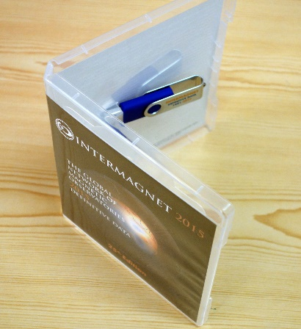
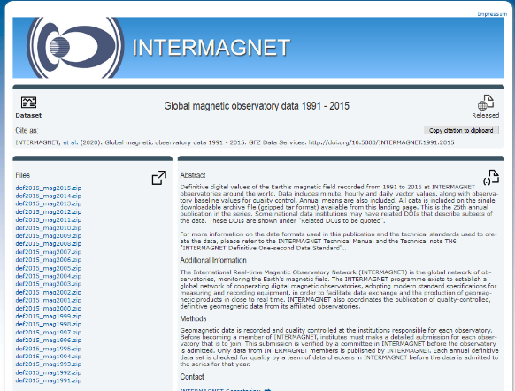
Compilations and publications of 1-min definitive (since Ottawa Meeting)
USB2015 (1991..2015) produced and distributed by Benoit Heumez in Autumn 2019
IRDS2015 DOI (1991..2015) published in June 2020
Completed compilation IRDS2016 (1991-2016) already uploaded on:
- ftp://anonymous@datapub.gfz-potsdam.de/upload/INTERMAGNET-upload/
- ftp://steptwo@par-gin.ipgp.fr/IRDS2016/

Slide 8
Thank you for your attention !

